Slide 1
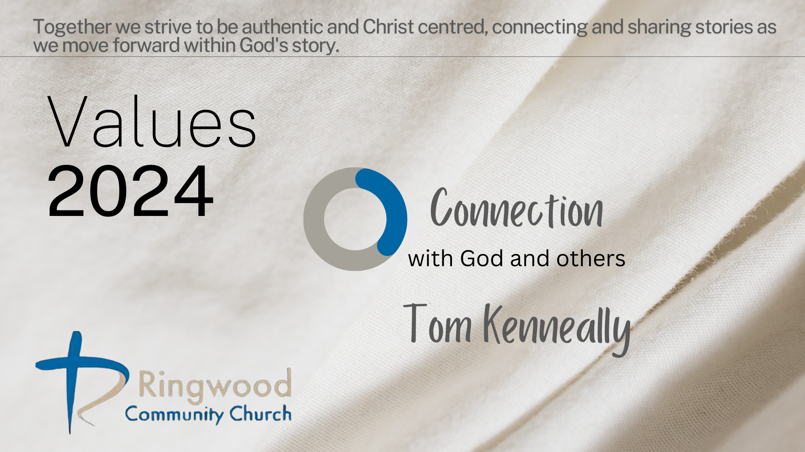

Slide 2
Connection with God
Mark 1:29-35
Jesus is in the city of Capernaum, at least two of his disciples lived here.
Jesus performs many miracles and helps a lot of people. We then see the next day:

Slide 3
Very early in the morning, while it was still dark, Jesus got up, left the house, and went off to a solitary place, where he prayed

Slide 4
Connection with God
This moment highlights the importance of solitude and communion with God
We see Jesus prioritise these moments so much that he starts his day with it.
It also sets Him on the right path and knowing his next steps with more clarity.

Slide 5
Connection with One another
Connection with one another is highlighted from the very beginning. We see adam in communion with God but then God creates another to be in relationship with. Eve.
From the start we are created to be connected to others.
Ecclesiastes 4:8-12

Slide 6
Connection within our faith community
Connection is suppose to be deeper than just social interaction.
It is the type of relationship where we experience God’s love and grace manifested through human relationships.

Slide 7
Opportunities and challenges
Join a small group that meet through out the week, or even just one on one with someone.
It is challenging: misunderstands, conflicts etc, but an opportunity for transformation: to show forgiveness, and extend grace.

Slide 8
Connection with the Lost
Luke 19:10, "For the Son of Man came to seek and to save the lost.“
Jesus consistently engages with people who are on the outer fringe of society.
Zacchaeus for example!

Slide 9
The call for us
We are called to actively seek those who are lost, those who are feeling broken, those who are searching for truth.
It will require a willingness to step out of our comfort zones.

Slide 10
What we can do:
We need to actively make choices that will bring us in to contact with those who don’t believe yet, not just to talk about God
We need to commit to addressing not only their spiritual needs, but ensuring that we care for all of their lives, physical, emotional etc.

Slide 11
Authentic:
“Let love be genuine”
A life marked by sincerity, integrity and true affection.
It is honesty, vulnerability and showing our true selves

Slide 12
The challenge: 3 steps
Create an open space for prayer, 20 minutes a day. For intentional DIALOGUE
Connect with someone from church this week, call them up, and catch up for coffee or lunch.
Look at your calendar, where do you come close to a non-believer? use that time intentionally, or create an opportunity for yourself.

